Slide 1
BOOK RECOMMENDDATION SYSTEM
By..
Vinodkumar

Slide 2
Contents
Problem Statement
Data Overview
Data Preprocessing
Exploratory Data Analysis
Recommender Systems
Evaluation
Deployment

Slide 3
Problem Statement
In General recommender systems are algorithms aimed at suggesting relevant items to users (items being movies to watch, text to read, products to buy, or anything else depending on industries).
Recommender systems are really critical in some industries as they can generate a huge amount of income when they are efficient or also be a way to stand out significantly from competitors.
The main objective is to create a book recommendation system for users.

Slide 4
Data Overview
This Book-crossing dataset contains three files: Users, Books, Ratings.
Users
User-ID: Unique ID of each user
Location: Location of the user
Age: Age of the user
Books
ISBN: The International Standard Book Number is a unique numeric Identifier
Book-Title: Title of Book corresponding to an ISBN
Book-Author: Author of the book
Year-Of-Publication: Year of Publication of the book
Publisher: Publisher of the book

Slide 5
Data Overview (Cont.)
Image-URL-S: Small cover image url to a book
Image-URL-M: Medium cover image url to a book
Image-URL-L: Large cover image url to a book
Ratings
User-ID: Unique ID of each user
ISBN: The International Standard Book Number is a unique numeric Identifier
Book-Rating: Book-Rating are either explicit, expressed on a scale from 1-10
(higher values denoting higher appreciation), or implicit, expressed by 0.

Slide 6
Preprocessing
It Involves in
Fixing Null Values,
Data Miss Matches,
Renaming Columns,
Handling Duplicated Values,
Data Merging

Slide 7
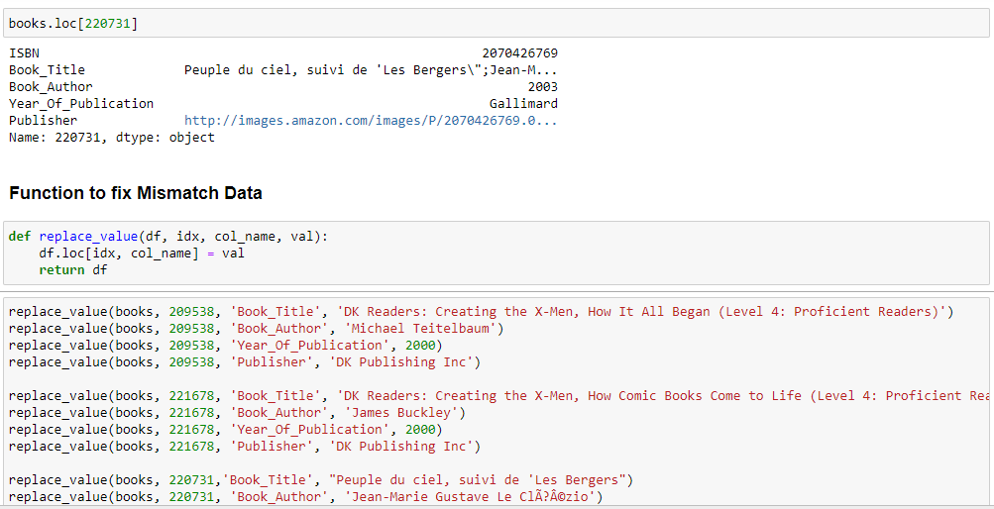
Preprocessing (Cont.)

Slide 8
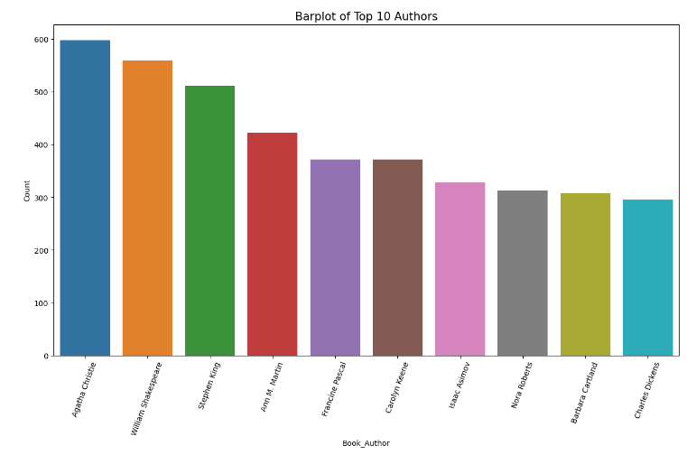
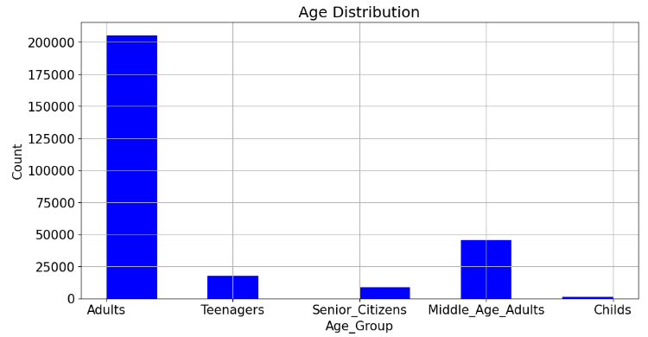
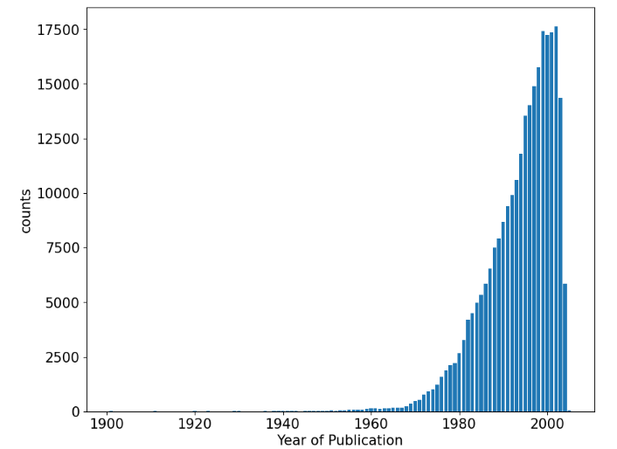
Exploratory Data Analysis (Dataset Level)

Slide 9
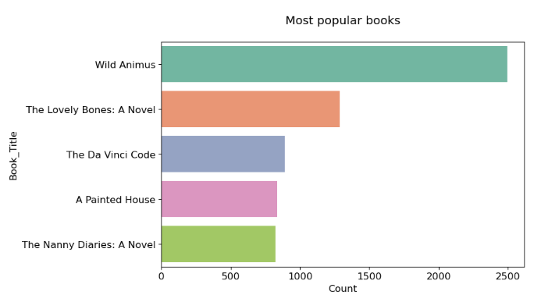
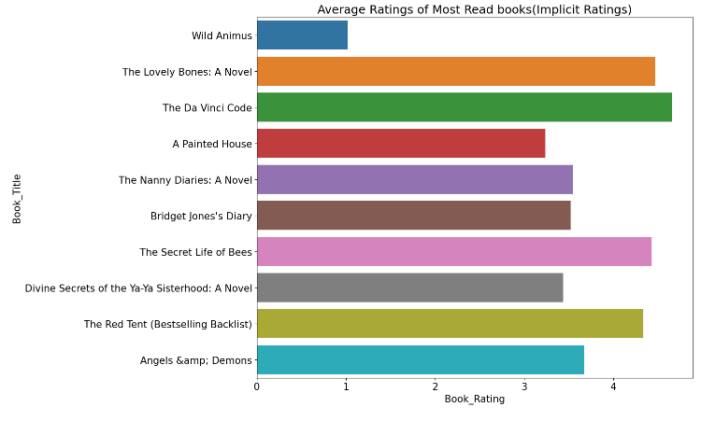
Exploratory Data Analysis (Merging Datasets)

Slide 10
Recommender Systems
In this Project We main focused on
Popularity Based Recommendation System
Collaborative Filtering (User-Item Based)

Slide 11
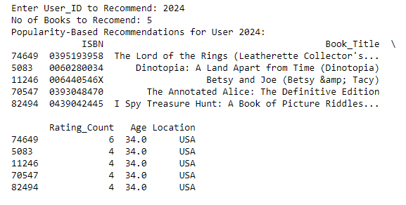
Recommender Systems(Cont.)
Popularity Based Recommended System
We Recommend books to User on Popularity Basis with respect to Age and Location

Slide 12
Recommender Systems(Cont.)
Collaborative Filtering
Collaborative filtering is used in recommendation systems to make predictions about a user's preferences based on the preferences and behaviour of other users.
User-Item collaborative filtering specifically focuses on similarities between users.
Steps involved in Collaborative Filtering are Data collection, User-Item Matrix, Similarity Calculation, Neighbourhood Selection, Recommendation Generation, Evaluation, Optimization and Continuous Improvement etc.,

Slide 13
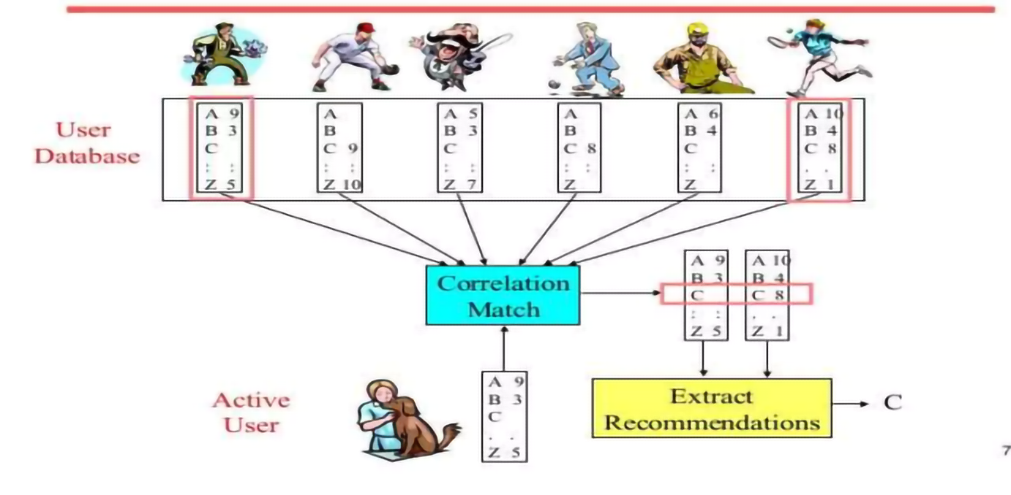
Recommender Systems(Cont.)

Slide 14
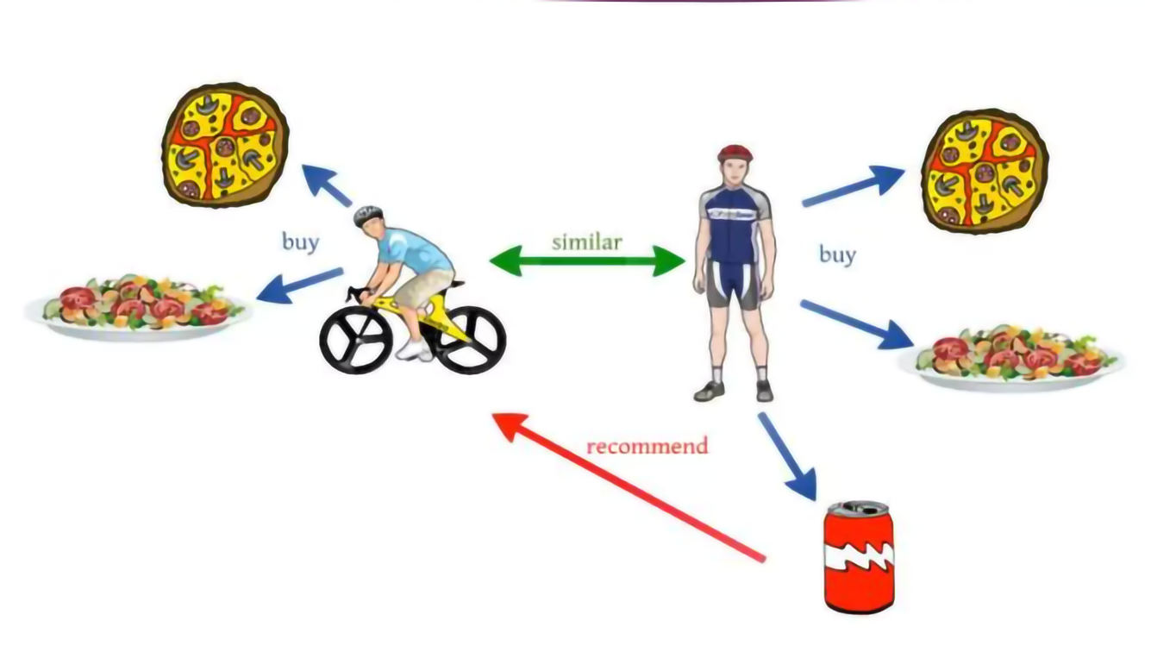
Recommender Systems(Cont.)
Collaborative Filtering User-Item Based

Slide 15
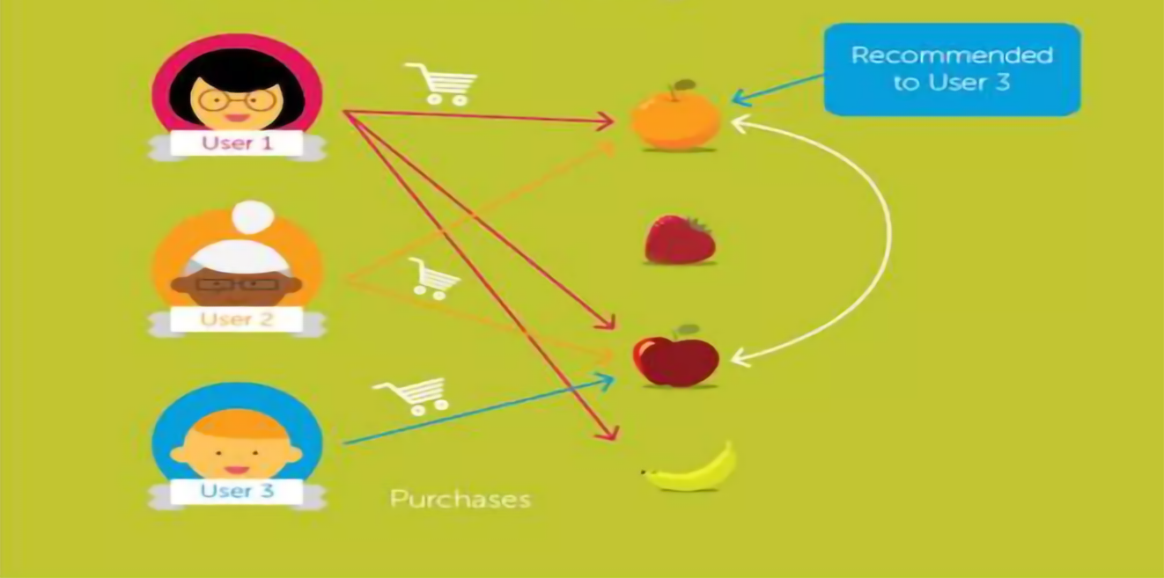
Recommender Systems(Cont.)
Collaborative Filtering Item-Item Based

Slide 16
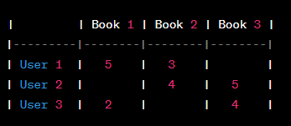
Recommender Systems(Cont.)
Singular Value Decomposition (SVD)
Singular Value Decomposition (SVD) is a matrix factorization technique that plays a crucial role in various fields, including linear algebra, signal processing, and machine learning.
In the context of collaborative filtering for recommendation systems, SVD is used to decompose the user-item interaction matrix into three matrices:
a user matrix,
a singular value matrix, and
an item matrix.

Slide 17
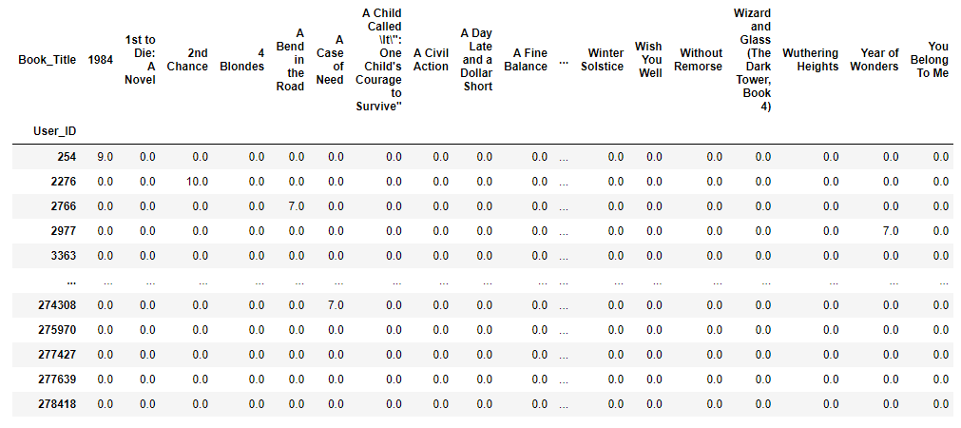
Recommender Systems(Cont.)
User-Item Interaction Matrix

Slide 18
Recommender Systems(Cont.)
Advantages of SVD for Collaborative Filtering:
Personalization:
SVD captures personalized user preferences by learning latent factors that influence ratings.
Handling Sparsity:
SVD handles sparse matrices well, making it suitable for recommendation systems where users only rate a small fraction of items.
Dimensionality Reduction:
Reducing dimensionality helps in capturing the most important latent factors, leading to more efficient and less noisy models.
Improved Accuracy:
SVD-based models often outperform simpler collaborative filtering methods by capturing complex patterns in the data.

Slide 19
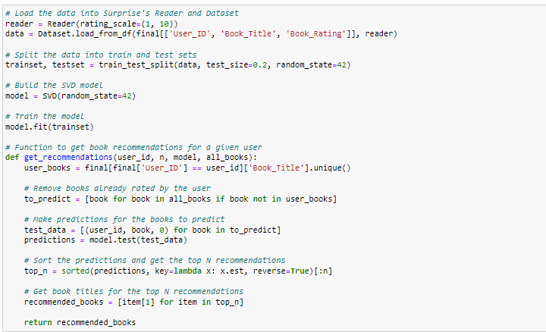
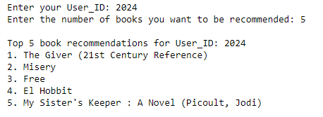
Recommender Systems(Cont.)

Slide 20
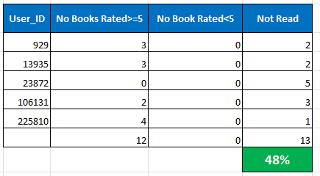
Evaluation
Evaluation was carried by Choosing five random Users and ratings to books

Slide 21
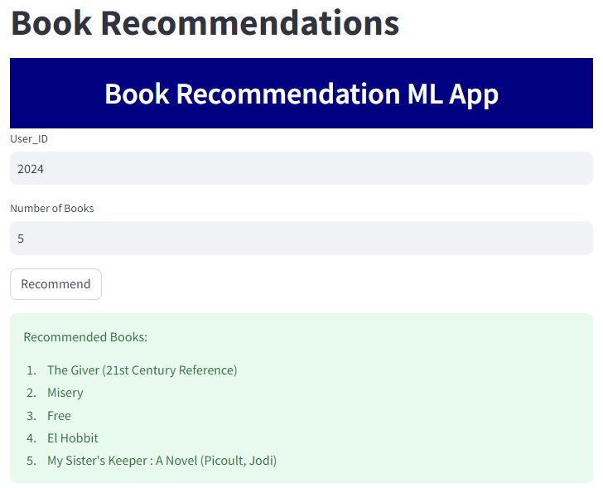
Deployment
Deployment Was done with the Help of Pickle and Stream lit Libraries

Slide 22
Conclusion
The initial step, of our project was Data preprocessing of the three datasets-Books, Users and Ratings, wherein we removed duplicates and imputed the missing values & invalid entries with appropriate values andcorrected spellings .
We have done Some Exploratory Data Analysis to Understood the data and some conclusions were drawn which helped us in Model Building.
Then, we used Popularity-based approach, Collaborative filtering approach to built different types of recommendation models.
We evaluated the performance of Singular Value Decomposition based recommender and obtained 48%%

Slide 23


